Slide 1

Carsharing App

Slide 2

Authors
Petr Ambrož
Adam Bruzl
Stas Dochynets
Jan Novák
Ondřej Žlezňák

Slide 3
The Vision...
The Carsharing App connects car owners (lenders) with individuals who need temporary access to a vehicle (borrowers).
The platform facilitates the rental process, ensuring security and convenience for both parties.
Lenders can earn money from their idle cars, while borrowers can access vehicles without the long-term commitment of ownership.

Slide 4

User stories

Slide 5

User stories
Vehicle listing
Viewing car details
Rental conditions
Car search filtering
Visible reviews of possible borrowers
Direct lender – borrower communication
Booking a selected car
Automatic insurance coverage
New offers notification
Terms violation notification
Borrower review
Marking vehicle as returned

Slide 6
US – 001: Vehicle listing
As a car owner, I want to list my car for sharing when it's not in use so that I can earn extra income from an otherwise idle asset.

Slide 7
US – 005: Visible reviews of possible borrowers
As a car owner, I want to see reviews of a possible borrowers, so that I can decide if I can trust them with my car.

Slide 8
US – 006: Direct lender-borrower communication
As a borrower, I want to communicate with the owner of borrowed car directly so that I can resolve potential problems and incidents easily.

Slide 9
US – 007: Booking a Selected Car
As a potential borrower, I want to reserve a selected car for a given date and time so that I can ensure a vehicle is available when I need it.

Slide 10
US – 010: Terms Violation Notification
As a car owner, I want to be notified if a borrower violates the agreed terms (e.g. drives out of specified area) so that I can immediately take action and protect my car.

Slide 11

Use cases

Slide 12
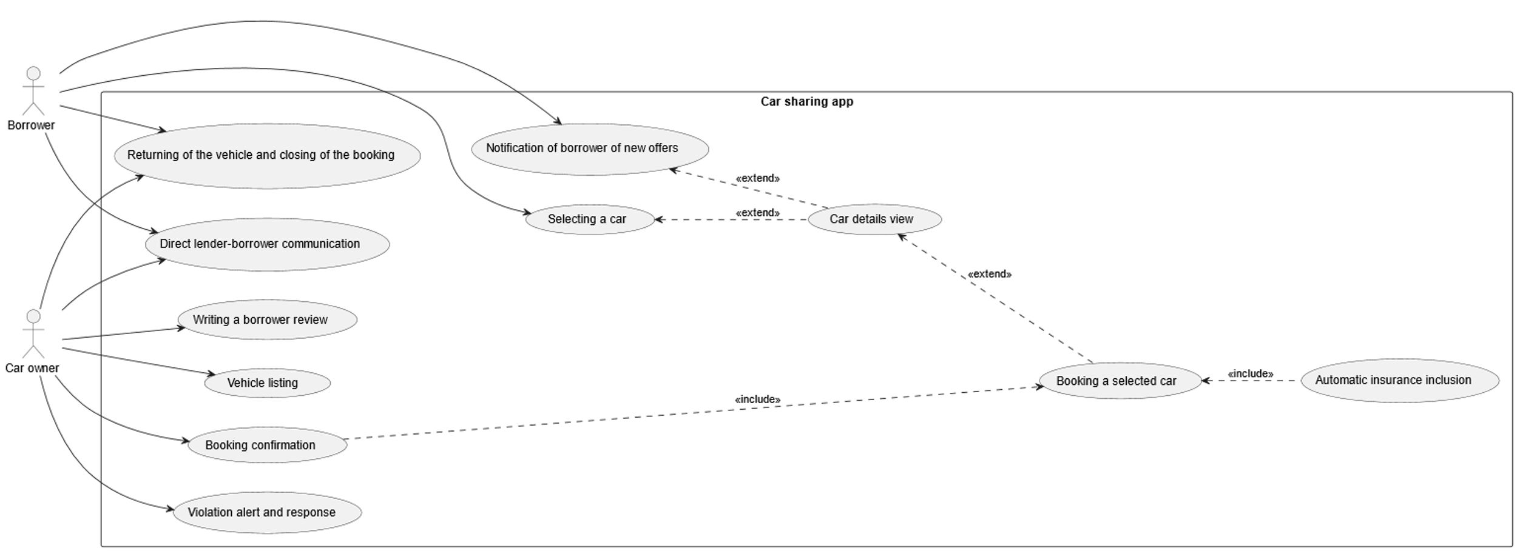
Use case diagram

Slide 13
UC – 002: Selecting a Car
Basic Flow
User navigates to the "Browse Cars" section
System displays all available cars
User selects the "Filter" option
System displays available filter criteria:
Price range (minimum to maximum)
Car type (e.g., sedan, SUV, electric)
Vehicle availability
Location or distance from user
Transmission type (manual, automatic)
Additional features (e.g., air conditioning, child seat, pet friendly)
User sets preferred filter values based on their needs
User submits filter preferences
System applies filters and updates the list of available cars accordingly
User browses filtered results
User may refine filters or reset them as needed
Alternative Flows
7a: If no cars match the selected filters, system displays a message and offers to broaden search criteria
Postconditions
User is presented with a list of available vehicles that match their specified preferences
Actor: Potential Borrower
Related user stories: UC – 004: Car search filtering
Preconditions
User has registered and created an account
User has verified their identity (including having valid driver's licence)
User is logged into the platform

Slide 14
UC – 008: Violation Alert and Response
Basic Flow
The borrower starts using the car according to the confirmed reservation.
The system continuously monitors location in real time.
The borrower violates a usage restriction (e.g., leaves allowed geographic area).
The system detects the violation automatically.
The system immediately sends a real-time alert to the car owner (In-app notification)
The alert includes type of violation (e.g., out-of-bounds location), location, suggested next steps
The owner opens the notification and reviews the incident details.
The system offers possible actions : contact borrower via messaging, notify platform support, request early termination of the rental
The owner selects an appropriate action, and the system confirms and logs the response.
Alternative Flows
3a. If the monitoring device is temporarily offline, the system alerts the owner of tracking failure and resumes checks when back online.
Postconditions
The car owner is informed in real time of any serious usage violations.
The platform records all violations to support future safety checks, insurance claims, or conflict resolution
Actor: Car owner
Related user stories: US – 010: Terms violation notification
Preconditions:
The car has an active reservation and is currently in use by a borrower.
The owner has defined specific usage restrictions in the listing (e.g., geographic boundaries, no highway driving).
The vehicle is equipped with tracking/monitoring features enabled via the platform or integrated device.

Slide 15
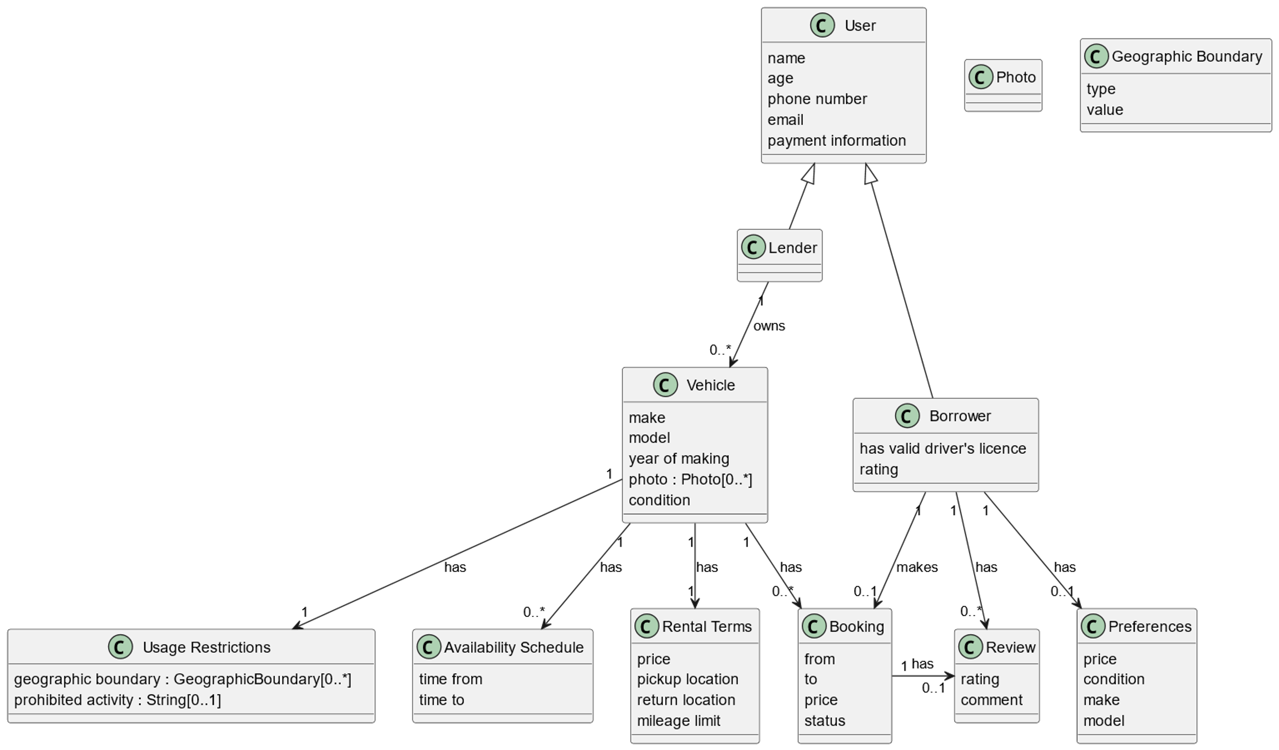
Domain model

